Slide 1

Tankards Associates
Presentation
By
Andrew Han

Slide 2

Defining Tankards
Toronto, Ontario based Law firm
Founded in 1993 ( 23 years old)
Focus audience :
Construction / architecture
Engineers
Local, but not limited to, corporate and commercial businesses

Slide 3
Translating Branding to Design
Branding
Design
Powerful
Reliable
Professional
Geometric Solid Shapes
Blue & Gray Colors

Slide 4
Sitemap
Index
About Us
Attorneys
FAQ
Contact Us
Solid geometric shapes and simple colors throughout.
Easy to find CTA
We want to attract engineer and construction clients

Slide 5
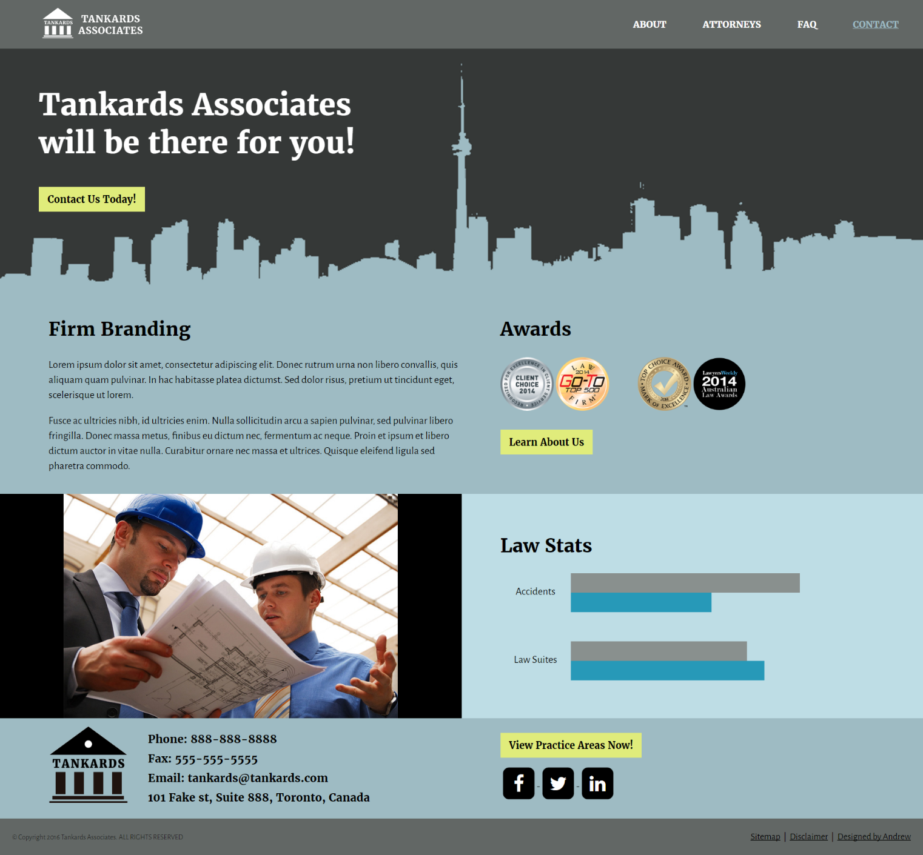
Index Page
4 colors
Geometric Image of Toronto blending in
Simple UI
3 CTA: top, middle, bottom
Firm Branding, Awards, Stats give a feel of professionalism and trust.

Slide 6
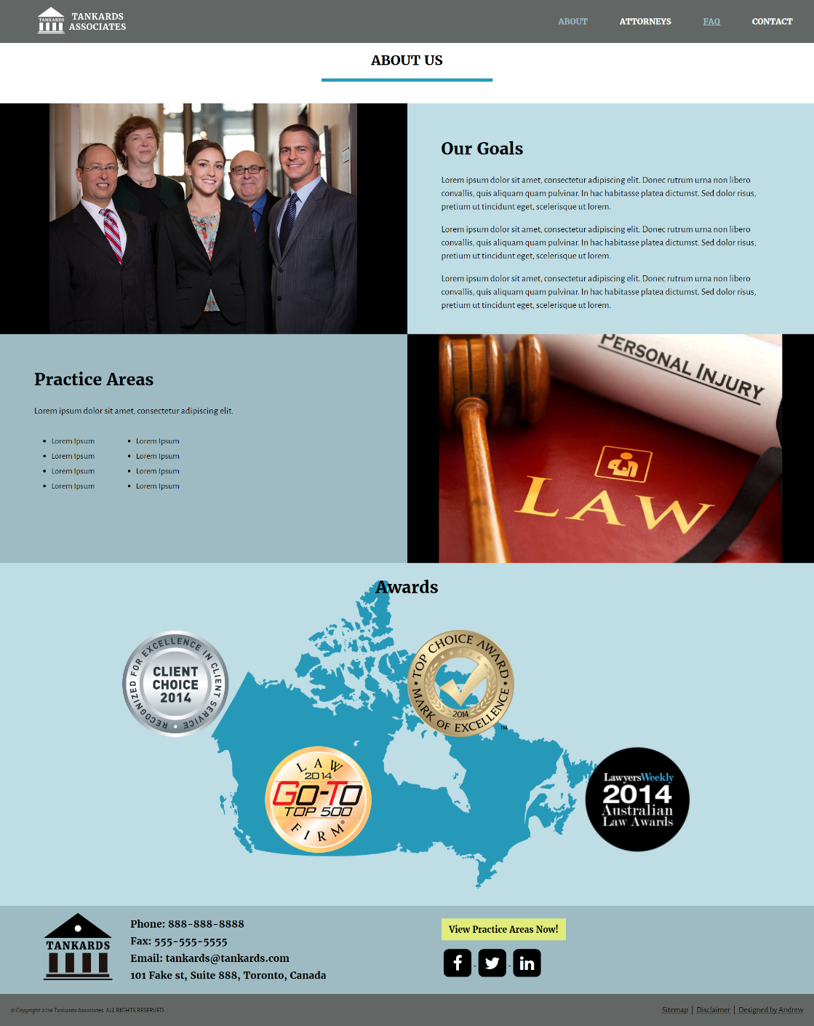
About Page
Identical Head and Foot (for all pages)
Consistent Design
More detailed information
Easy to read list of Practice Areas
In-depth Awards image

Slide 7
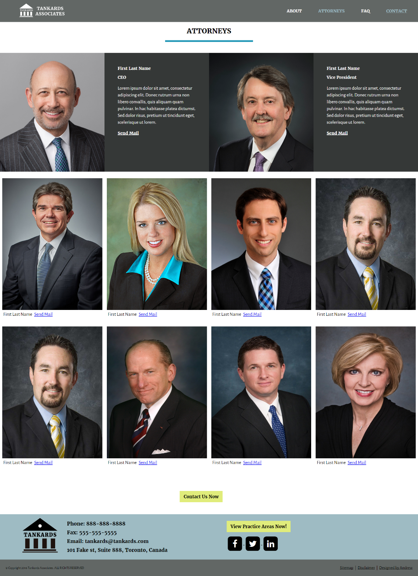
Attorneys Page
Image, Name, and contact for attorneys
Top: CEO & VP
Row 2 & 3: Leading attorneys
CTA: Contact Us Now
Send Mail mailto anchor.

Slide 8
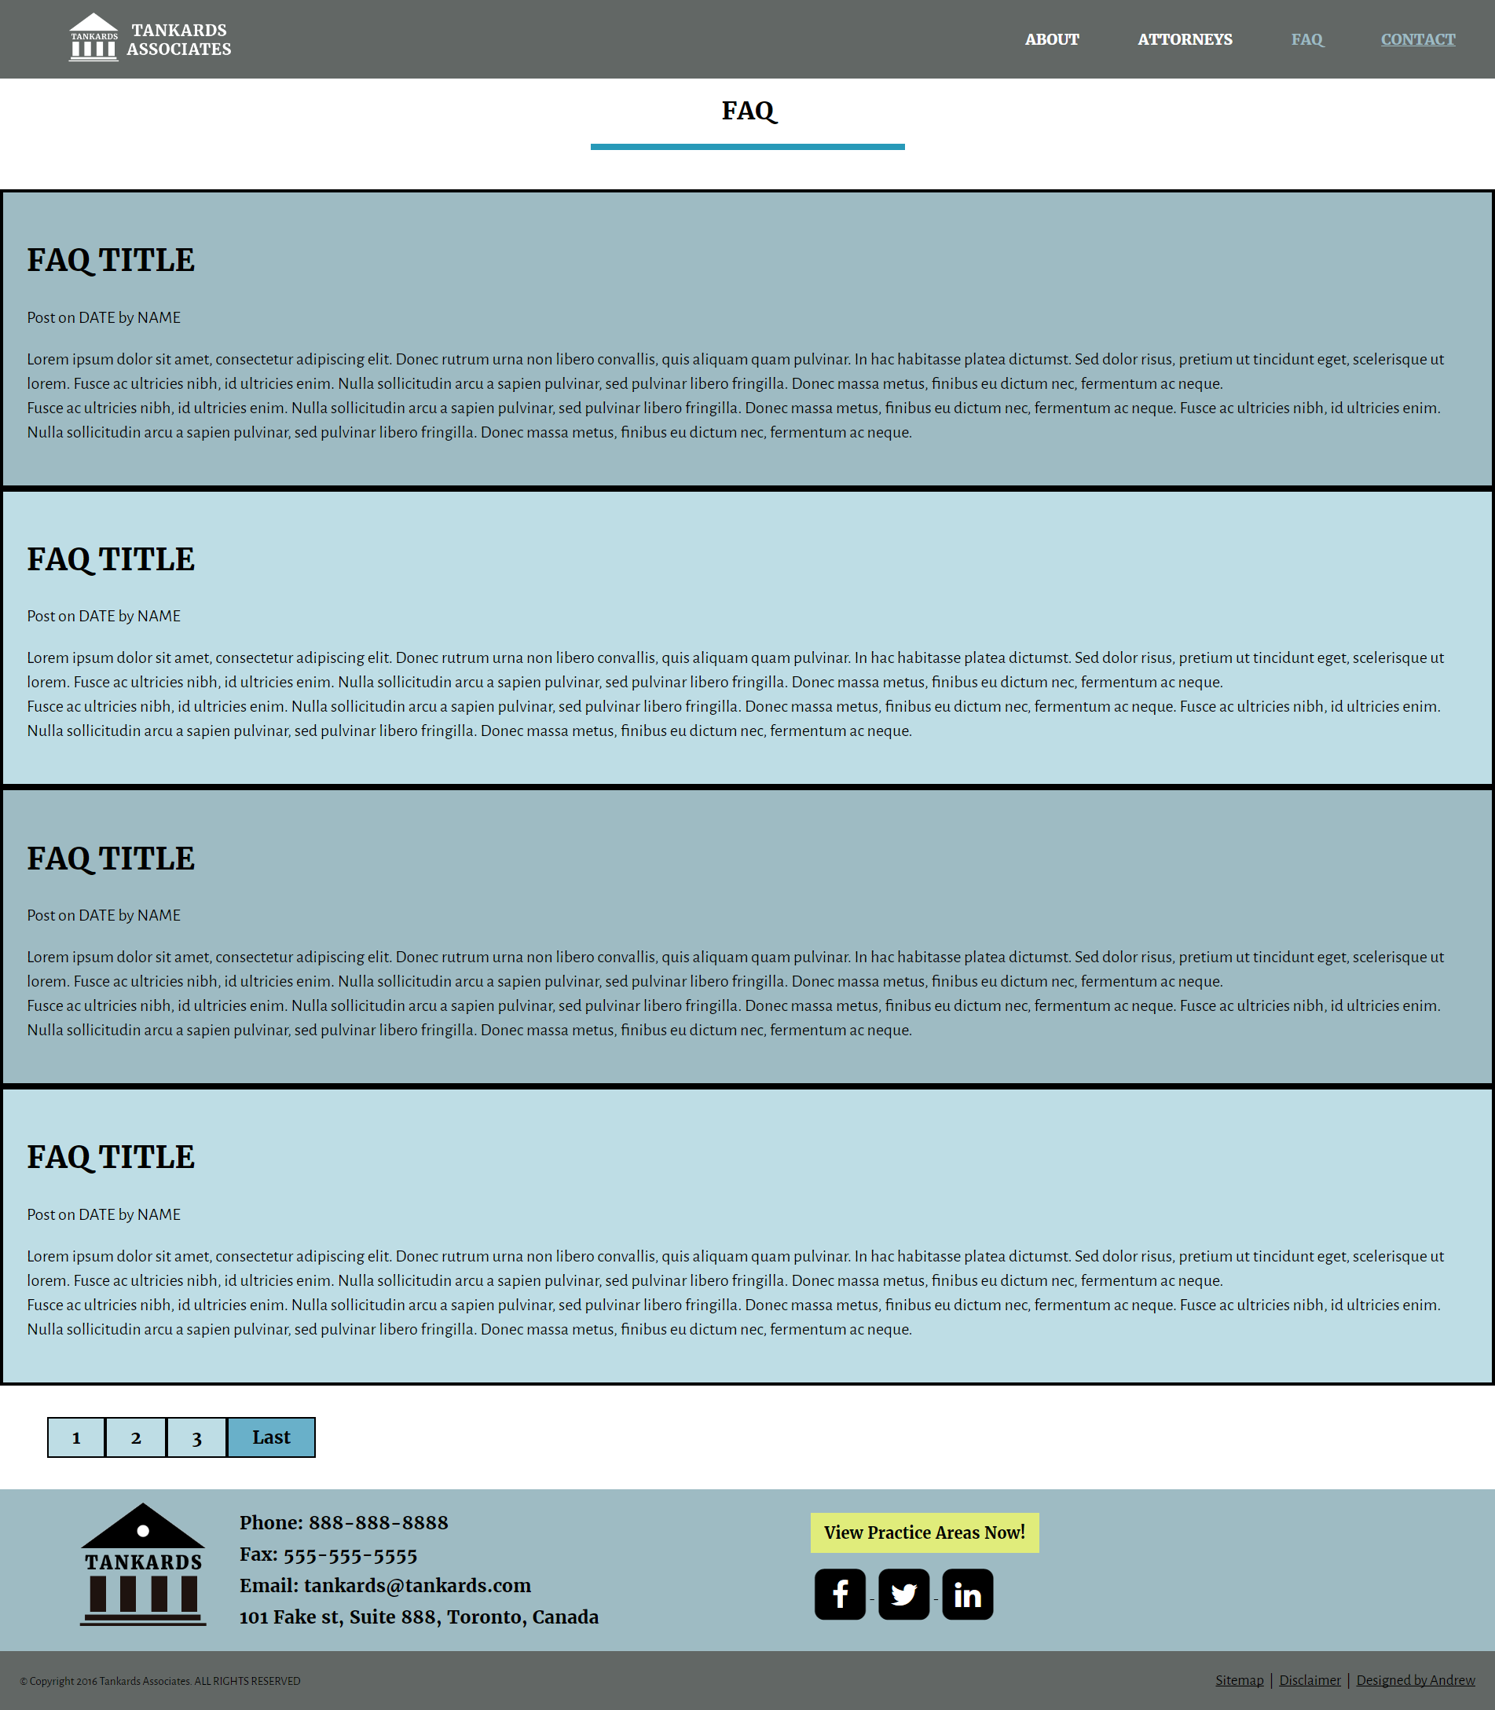
FAQ Page
Top FAQ questions
Page Buttons
Still using same colors throughout the page

Slide 9
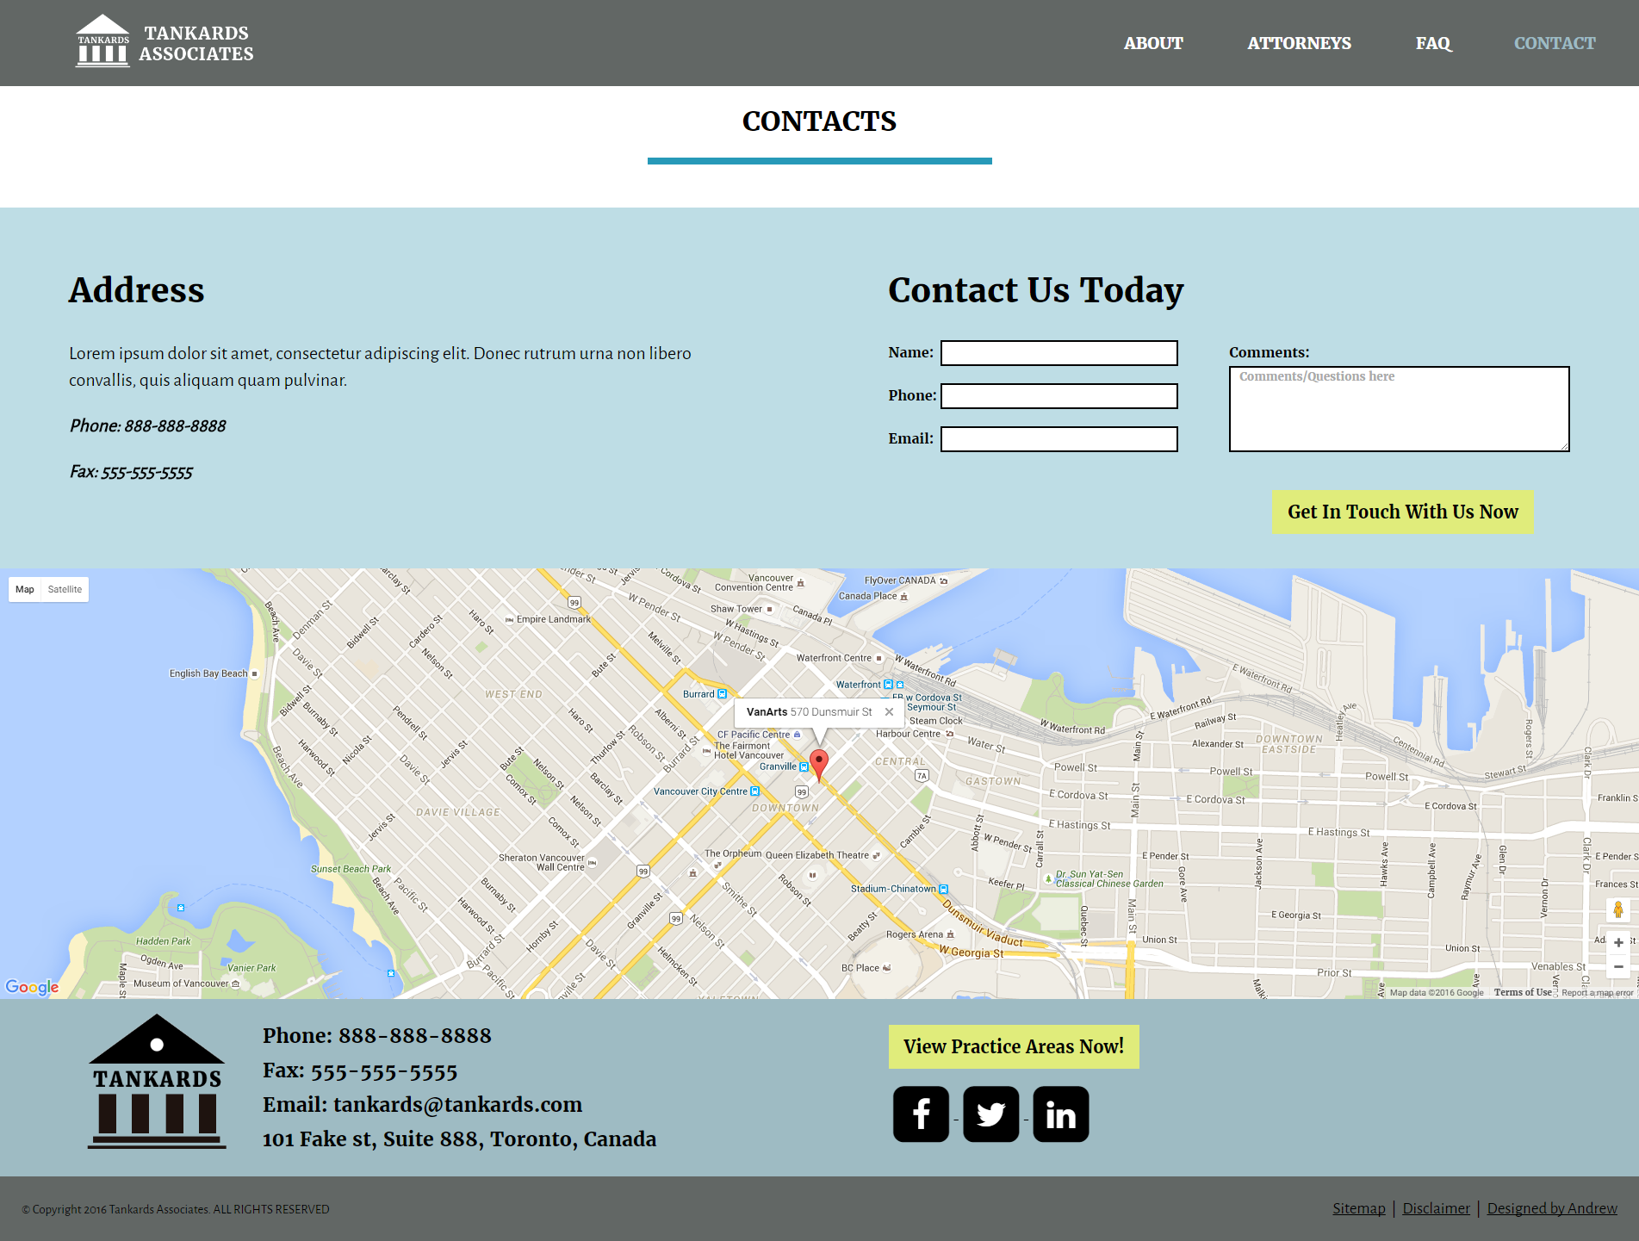
Contacts Page
Top left: Office address and Contact Information
Top right: Contact Form
Wide Google Maps

Slide 10

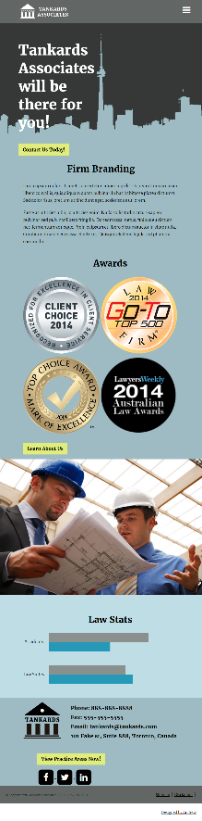
Responsive…
Desktop
Mobile

